Slide 1

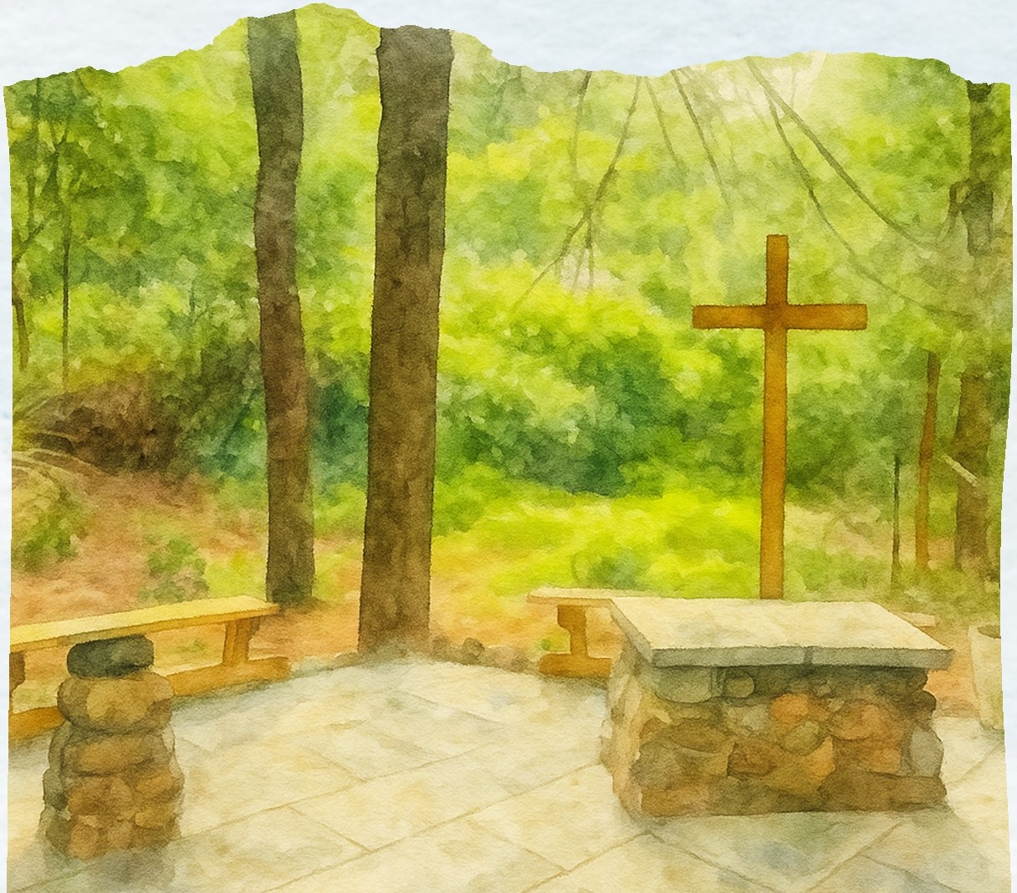



JULY / AUGUST 2026
----DUNN'S CORNERS COMMUNITY CHURCH----
Inside this Issue
Letter from Pastor Gin
Session News Deacon News Missions Stewardship News
Membership & Communications Music & Worship Arts
Teen Time Presbyterian Women
Children's Worship & Arts
Membership Spotlight Christmas Bazaar Picnic Pies
Events Bulletin Board Calendar
Diamonds Among Us
1
2
2
3
4
4
5
6
6
7
8
9
10
11
12
13
14
What a way to kick off the summer! The picnic at Ninigret Park was an incredible time of fellowship, food, and fun! Around 100 of you came, and the weather was perfect. Thank you to everyone who attended. Special thanks to those who brought food, and extra special thanks to Lynn Getty and Grant Showacre for preparing many of the essentials, and Carl Kellers and Bill Heep for handling the grills.
But friends, the real dreamer/creator of the picnic and games was Andy McCauley-Wallace. They were his idea. And I'm grateful for his vision for the day - the whole day!
It started with rehearsals (an hour early) for the choir, the Glory Ringers, and the Children's Chime Choir. At the end of every musical season, the choir sings Sacrifice of Praise, so it was familiar to many, but this time, Andy had composed a handbell accompaniment to Sacrifice of Praise! It was outstanding!
And my goodness, to hear the Children's Chime Choir playing "I Love You, Lord" made me so happy! I know many of you have fond memories of your children or grandchildren playing in the Children's Chime Choir from years gone by. In fact, Andy was originally hired at the church thirty-one years ago to direct a children/youth bell program. To witness its revival is really, really special.
It's bittersweet that these musical programs will be on a summer break until Rally Day on September 13th, but they deserve a rest after a very full year.
And wasn't the confirmation Devlin and Carlie made and the reaffirmation Katie professed incredible signs that Cod's Spirit is still moving in the lives of young people?
We certainly ended the program year on a high note, but we're not closing the doors until the fall! In the summer, come as often as you can to Sunday worship and the many activities we have planned! We'll have beautiful solos and duets during worship. We'll be in the Chapel in the Pines at 8 a.m., and we'll build Habitat homes together on July 11th! There's so much more joy and
fellowship to come!
90
1
www.dunnscornerschurch.org

Slide 2








Thi s su m m er, you may noti ce so m e chang es h app ening ar ou nd t he chu rch. As we prepare for the relocation of the chu rch o ffi ces, I h ave been helpin g clean out closets and so r t t hr o u g h piles (and
Fr om the papers of Flo r ence Madison:
The Re v. Malcolm Moccubbin intr oduced the glor ious in stitu tio n of
voca tion chur ch sc hool. As if the program, it se l f, w ere not gr uelin g enough, he olWOhJS hod the group sin g and enact "Ri se and Shin e." After a little risin g so m e hod nothin g to give but the glor h). Theh} w ere sh a m ed bh} a m u ch
o lder wo m an who kept going str o n g to the end, then turned with beaming fa ce and sa id, "Isn 't thi s w on d er ful? I w o uldn 't m iss it fo r onh}thing.
piles!) of discovered documents
paper. Alo ng t he way, I a t r easu r e t r ove of
fr om the founders of the
chu rc h. I h o p e to sh ar e so m e of these documents on the chu rch w eb sit e in the fu tu re.
Today, I w ant t o sh ar e one of the st o r ies I found am o ng t he papers of Flo r ence Madison. In the ear ly 19 0 0 s, t h er e was no chu rch in Dunn' s Co rn ers. How ever, a Su nd ay Sc hoo l was or ganiz ed in 19 28 and co nt inu ed until 19 41. In 19 44, a n ew Su nd ay Sc hoo l was est ab li sh ed, and fr om t hat m ini st r y our c hu rch was born.
Th at sa m e sp ir it o f j o y and fell o w ship cont inu es t hr o u g h o u r Vaca t io n Bibl e Sc hool( VBS). I h o p e to see you at t he VBS picnic!
Deacons who are faithfully serving the congregation are: Rose Marie Bartol, Keith Bruns, Stephanie Cahoon, Olympia Graeve, Karen Ingalls, Bonnie Krauss, Gordon Preiss, Stacey Pride, Sandy Santy, Doreen Smith, Cheryl Spino, and Susan Strouse.
Warm Shelter Dinner:
Vo lu nt eer s are n eed ed to
make and help serve a Sw iss chicken dinner at the W ARM Shelt er the fir st Sa t ur d ay of
eac h mont h. (Not in July because the first Saturday is
Independence Day!) The next date will be Saturday, August
1 from 3:00-6:00. Vo lu nt eers w ill h eat, set up and serve the
food. No clean up required.
Food & Fellowship Ministry:
Co ff ee hour, memorial
co ll ati ons, h o lid ay dinners, and Di am o nd lu nches are sig nifi cant ways we can j o in
t o ge ther and sh ar e food and fr iend ship in sid e and out sid e the co ngr egati o n. Th ank you for sig nin g up t o provide
refr eshm ent s for t h e
co ngr eg at io n aft er chu rch services. In the sum m er, enjoy donuts and co ff ee during
co ff ee hour aft er chu rch
ser vices o n Su nd ays. Donuts are delivered each Sunday in July and August- so please join us and sig n up t o h elp
w it h co ff ee and quick clean up. Easy as pie! See Sandy Santy with questions. Thank you!
Jonnycake: Th ank you to the
co ngr egat io n for your co ntinu ed
su pp o r t o f t h e Jonnycake Cent er. As we loo k forward to sp r in g, we co uld u se these it ems:
Juice
Condiments
Soup
Crackers
Please sig n up o n t h e bulletin board if you'r e int er est ed in helpin g su p p o r t t hi s
co mmunit y minist r y. Call Doreen Smith at (401-429- 8969) with questions.The W ARM Shelt er is lo cat ed at
56 Sp r uce St r eet in W est erly.

Slide 3





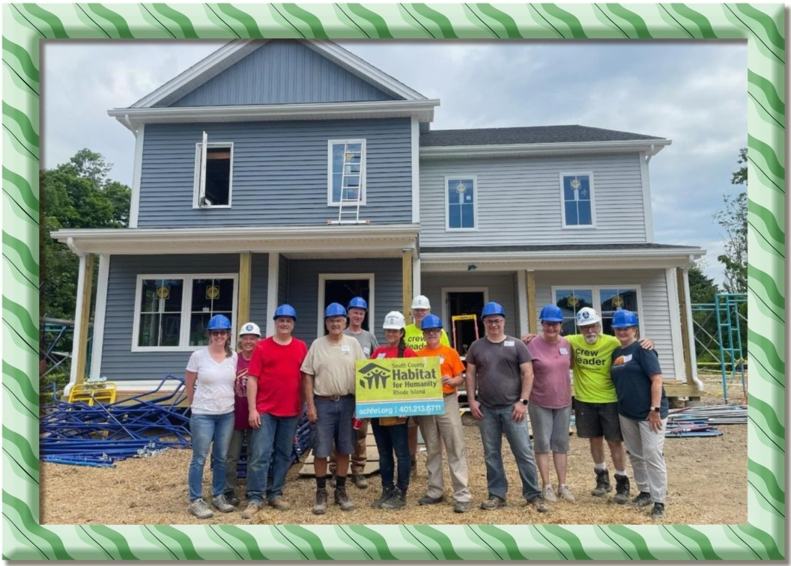
Missions Headlines
SERVING OUR COMMUNITY THROUGH FAITH AND ACTION
1vr
Habitat
for Humanity
ORCAS INTERNATIONAL
The Mission Committee met on June 4 and welcomed guest speaker Jen Fyrer, a 7th-grade math teacher at Chariho Middle School. Jen leads the CMS (Chariho Middle School) Care Closet, a vital resource serving approximately 800-900 students. The Care Closet provides new and gently used clothing-especially hoodies, pants, and sneakers-as well as snacks and weekend food support, including easy-open canned goods.
WOULD YOU LIKE TO HELP?
In te r e sted in vo lunteer i ng w it h
DCCCP at Ha b it a t fo r H u m a ni t y?
Sca n the QR co d e fo r m o r e
i nf ormatio n and to be added to our volun teer li st. (O R sign up on t he
bullet i n board in Fellow shi p Hall)
Jen shared that the program is currently supported largely by teachers and works in coordination with staff assisting students experiencing homelessness. The Closet is available to any student in need, ensuring dignity and access to basic essentials.
t1if
Habitat
for Humanity •
When asked how we can help, Jen suggested several meaningful ways to get involved:
Donate new or gently used sneakers (youth sizes appropriate for grades 5-8)
Provide financial support to purchase sneakers (for example, through retailers like Walmart)
Help spread the word to other churches and
community groups to expand support
HABITAT BUILD
DCCCP Habitat Crew received a shout out
from SCHH in their latest newsletter. "Finally, we hosted another open build with members of Dunns Corners Church, who continue to show up with dedication and go above and beyond in their support of our work. It was on action-pocked week during a wonderful time of year, and we ore truly grateful to each and every volunteer who contributed their time and energy".
The Mission Committee is exploring hosting a sneaker collection during Vacation Bible School and researching potential grant opportunities to further support this effort. We will also reach out to contacts at Westerly High School to assess additional student needs in our area.
Habitat for Humanity Build Day - July 11 We are excited to present South County Habitat for Humanity with a $5,000 donation on Friday,
July 11, during our sponsored build day in Westerly. The duplex project is nearing completion, and
many volunteers are needed to help bring it across the finish line. There is truly a role for everyone­
no construction experience necessary! If you're interested in lending a hand, please consider
signing up. Contact Jerry Wolstencroft, visit the sign-up board in Fellowship Hall for more details,
or scan the QR code above.
3

Slide 4




As we transition into the summer months and activity slows, the Stewardship Committee
Thank you for supporting Habitat for Humanity.
Thank you for looking after the Chapel.
Thank you for leading the Grief Group.
Thank you for praying for those on the prayer list.
Thank you for folding the Scribe newsletter.
Thank you for managing Sunday collections.
Thank you for hosting fellowship hour.
Thank you for supporting teen fundraisers.
Thank you for greeting attendees on Sundays.
Thank you for providing Sunday flowers.
Thank you for composing the Wednesday update.
Thank you for arranging the Sunday program.
Thank you to our dedicated staff members.
Thank you for attending Sunday services.
Thank you for being a financial secretary.
Thank you for encouraging the children.
Thank you for your devotion to Jesus.
Thank you for exemplifying stewardship.
would like to extend sincere appreciation to all
members and commitment. contributions-
friends for their outstanding We are grateful for your
Thank you for your financial generosity.
Thank you for your participation as committee members.
Thank you for volunteering at the JonnyCake Center.
Thank you for providing meals for the Warm Center.
Thank you for serving as ushers.
Thank you for preparing and serving communion.
Thank you for assisting with worship services.
Thank you for overseeing sound and
streaming during services.
Thank you for singing in the choir.
Thank you for ringing the bells.
Thank you for supporting Sunday activities.
School
Thank you for your involvement as Tuesday volunteers.
Thank you for maintaining the Memorial Garden.
Thank you for caring for the flower beds and
Above all, thank you, Jesus, for your presence among us for thirty-three years and entrusting us with the responsibility to love one another.
•
mowing the lawn areas.
• • • • • •••••
Weareso grateful for the incredible turnout at our recent picnic-it was truly a wonderful time of fellowship, laughter, and community. It was heartwarming to see so many familiar faces, along with new ones joining in the fun. From great food to meaningful conversations, the day was a beautiful reminder of the strength and spirit of our church family. Thank you to everyone who attended, volunteered, and helped make the event such a success.
You asked, and we listened! We're excited to share that the Scribe has been updated with a slightly larger format and bigger fonts for easier reading. We hope this change makes it more accessible and enjoyable for everyone to stay connected and informed. As always, we welcome your feedback as we continue to grow and improve together.
Behind the scenes, we are continuing to make strides in our messaging and outreach. Website improvements are currently underway, with a focus on accessibility, clearer communication, and making it easier for visitors to connect with us. Our social media presence is also growing­ interactions have increased by 30%, with over 20,000 views in the last 90 days. Even more exciting, more than 70 % of those views are coming from people outside our church community. This is a strong sign that our message is reaching beyond our walls. You can help extend that reach even further by liking and sharing our posts!
Wishing you all a happy, safe, and blessed July and August. May these summer months bring you rest, joy, and meaningful time with family and friends. We look forward to seeing you in worship and
fellowship throughout the season. , ._ _
(lJ?( .
9fl1A,ft, o/Cl1/ult L1 9-o/ f l;f
4

Slide 5


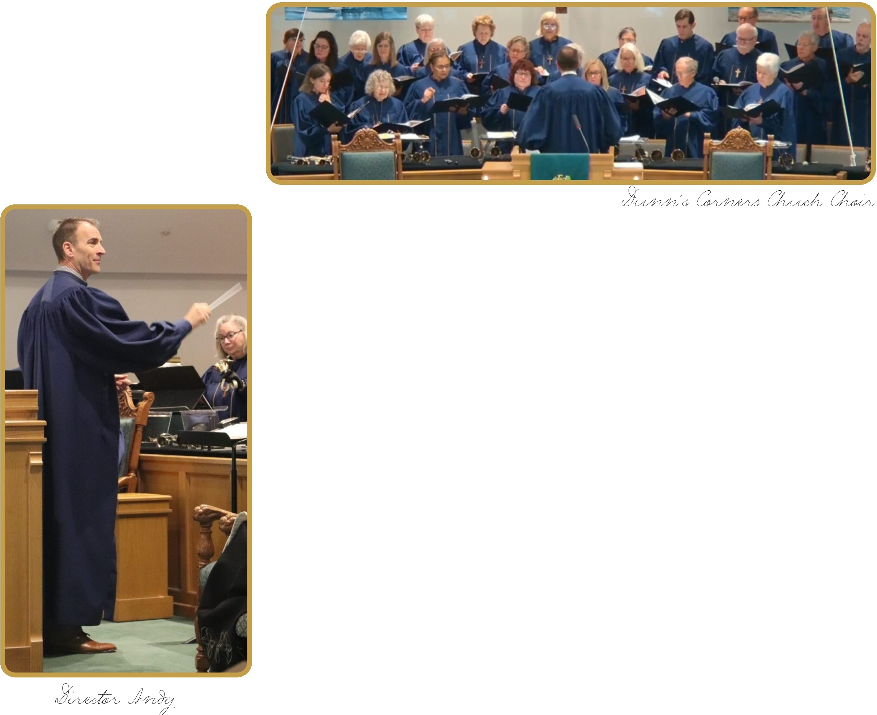
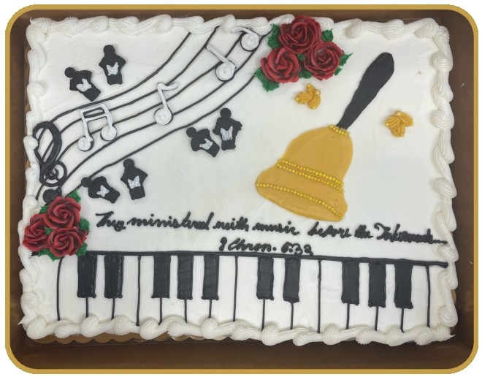

favorite Hymns
During the summer months, the
congregation is
d to request
encourage
a favorite hymnfo_r
_{any upc}oming worship
Come and be a part of the summer choir. This is open to everyone. We will gather on Sunday July 26th at 9:15 am in the Music Room and prepare a fun upbeat anthem to sing at the 10 am worship service!
.e Please ask an
servIc • . d
usher for a slip or fin
_{one on} the back table
d
in the sanctuary an place it in the offering plate.
Music Appreciation Sunday was a beautiful reminder of what it
means to be a community of faith lifted in song. I am deeply grateful to Cheryl and Kathy for their faithful leadership and the care they bring to our shared ministry. I also give thanks for the members of
the Chancel Choir, the Glory Ringers, and our Children's Chime Choir, whose time, energy, and joy filled the sanctuary with richness and
spirit. What made the day especially memorable was the sound of the entire congregation singing together. That kind of wholehearted
participation is a gift anda powerful reminder of why music remains such an essential part of our life as a church. Thank you for your
continued support of our vibrant and growing music and worship arts ministry. It was truly a special Sunday.
5

Slide 6







111N -
- SUN'S OUT,
poi e • e's got y on rain
t
1 1MI", , GOD'S GOT YOU.
.--:
Teen Time continues throughout the summer on Tuesdays
from 5:00 p.m. to 7:30 pm. We look forward to gathering each week for fellowship, games, discussion, and f.a,,,ith building activities.
We're also in the process of planning our annual summer
water party. Details are still being finalized, so please keep an eye on the church bulletin and church emails for announcements regarding the date and any special information.
As this article is being prepared, several of our youth are attending a retreat in Texas with Pastor Gin. We wish them a meaningful and memorable experience and look forward to hearing about their trip when they return.
Thank you, as always, for your continued support of our
.v.
youth ministry and th young 9eople of our church.
v'
---- ■-
PW Summer Book Sale
The PW Summer Book Sale will take place in Fellowship Hall from Sunday, August 2 through Sunday, August 30.
Book donations will be accepted from Sunday, July 12 through Tuesday, July 28. Donations may be dropped off in the ELC hallway. Please do not leave any donations in Fellowship Hall.
We will be setting up for the sale on Wednesday, July 29, from 10:00 AM to 12:00 PM-helpers aregreatly appreciated!
.. ,... ,.
·• . ,*..*·. ...
We kindly ask that all donated items be in good condition.
Accepting: Not accepting:
Fiction
Non-fiction
Mysteries
Children's books
Puzzles
Romance novels
Craft or cookbooks
Magazines or newspapers
Hymnals
Religious or self-help books
The Presbyterian Women's Book Club will gather on September 7th at 7pm in the Meeting House to discuss the book Hamnet, by Maggie O"Farrell.
All are welcome and church membership
is not a requirement.
Pricing:
Hardcover books: $3.00 Paperback books: $2.00 Puzzles: $1.00
Children's hardcover books: $2.00 Children's paperback books: $1.00
For the convenience of our shoppers, the book sale will also be open on Saturdays from 9:00 AM to 12:00 PM, beginning August 8 through August 29.
There is no PW meeting in July or August. We will see you Monday, Sep 20 ^{th} at 1pm in Fellowship Hall. For more information please contact
Doreen Smith or Sharon DeSarro
.........
PW thanks you in advance for your support of this fundraiser!
6

Slide 7
CHI LDREN'S
MI NI STRY CORN ER
Children & Youth Ministry:
Looking Back and Looking Ahead! What a wonderful start to we've had! Sunday, June
incredible milestone day for
and youth during our single combined service.
First, our Children's Chime Choir blessed us with a beautiful performance during worship. Their hard work and talent truly brought extra joy to the sanctuary!
Picnic Fun at Ninigret Park
Following the service, the celebration continued at the whole-church picnic at Ninigret Park! The Children and Youth programs put together a church-wide scavenger hunt that got everyone moving and laughing.
Thank you to everyone who participated! We absolutely loved seeing all the creative and hilarious photos you submitted throughout the day. It was a beautiful afternoon of fellowship, food, and community. Check out the fun photos on page 11.
Coming Up Next: Vacation Bible School (VBS)
The summer fun is just getting started! We are so excited for Vacation Bible School, which will be running from July 13-17.
Get ready for a week filled with games, crafts, music, and learning more about God's love. Keep an eye out for final details, and please pray for our volunteers and the children who will be joining us for this special week!
Want to get involved? If you'd like to volunteer for VBS or help out with future Children and Youth ministry events, please reach out to Mary Slattery@
mfstlatterY-03@_gmail.com or (401) 569- 9584. We'd love to have you!
the summer
14 was an our
children
We also celebrated a sacred and exciting step in the faith journeys of three of our youth group members - Devlin David, Carlie Austin, and Katie Charette - who took their vows of Confirmation and Reaffirmation.
Please continue to hold these young people in your prayers as they continue to grow in
their faith. \ /
-
c:!)
7

Slide 8






What has kept you here?
We walk the talk at DCCCP.
Can you share a meaningful moment or experience you've had in our church community?
I thought it was very special when I received
communion from my wif"e, Sue.
Are you involved in any ministries, groups, or volunteer roles? If so, which one?
I serve as a trustee, as well as participate in the
compliance and stewardship committees. I also volunteer for Southern Rhode Island Volunteers.
What do you enjoy most about serving in this way?
It's a great way to meet people in the church
as well as the community.
How has volunteering impacted your faith or life?
Because I hove been so blessed, it is fantastic to be able to shore some of my blessings with others.
What does this church community mean to
you?
We hove met so many wonderful and inspiring people here. It's a great group to worship with. In what ways have you seen Cod at work here?
While other churches ore shrinking, we're
growing. That's certainly God at work.
What would you say to someone thinking about visiting or getting involved?
Come! We don't bite.
What inspires you right now?
Honestly, the way Scottie Scheff/er drives a golf" boll.
Is there a favorite Bible verse, quote, or
message you'd like to share?
There ore many but John 3:16 is certainly up
there.
"For God so loved the world that he gave his one and only Son, that whoever believes in him shall not perish but hove eternal life".
Each month, we're honored to highlight a member of our church family whose presence, gifts, and faith help shape our community. This spotlight offers a chance to get to know them a little better and celebrate the many ways we grow together.
My name is:
Bob Strouse
How long have you been a member of our community?
Four years (time f"/ies!)
Which service do you attend? 10am
Tell us a little about yourself (family, work,
hobbies, etc.)
I've been extremely fortunate to hove retired young so we've been able to travel, enjoy working in our yard and volunteering. We ore also expecting to be f"jrst time grandparents
any day now.
What are a few things you enjoy doing in your free time?
In the summer we love to spend time outside on our deck where we con watch the boots go by and nature oil around. Unfortunately, we definitely do not get to golf enough.
Is there a fun fact about you that people might not know?
Besides my moring shower, I hate to be wet.
(f"un enough??)
How did you first come to our church?
We hod been looking in town for a Christ centered and active church and we cerotinly hove found it here.
Morning person or Night owl?
N igh t Owl
Coffee or tea?
Coffee
8

Slide 9



While we aren't celebrating Christmas in July just yet, the Christmas Bazaar planning team is already hard at work preparing for one of our favorite churchwide events of the year!
Mork your calendars:
Our Christmas Bazaar will be held on Saturday, November 21, from 9:00 AM - 2:00 PM.
An event this wonderful takes a village, and there are plenty of ways you can get involved right now. We are currently seeking donations for the following areas:
= The Raffle - We consistently host one of the best raffles in town, and we need your help to make it amazing once again! We are looking for gift certificates and high-quality raffle items.
Deadline: We need confirmation of all raffle items by October 4.
Contacts: Mary Slattery at mfslattery03@gmail.com / (401) 569-9584 or Marilyn Brandyberry at mebrandyberry@gmail.com / (401) 622-3926.
_ Cookie & Soup Jars - Those delicious, crowd-favorite cookie and soup jars don't fill themselves! While we will need to collect the filling ingredients closer to the date, right now we are collecting wide-mouth, quart-size jars with metal lids.
Contact: Yvette Drurey at yvettebgd@cox.net / (401) 741-5792.
() Jewelry - Our jewelry table is always a huge hit. We are happily accepting donations of jewelry to refresh our inventory.
Contact: Jane Larkin atjalarkin@hotmail.com / (401) 439-7176.
. Cift Baskets - We are officially collecting items to build our famous themed gift baskets. To make donating easy, there is a designated collection bin located right in the Fellowship Hall where you can drop off your items.
Contacts: Cheryl Sping at tscs1382@verizon.net / (401) 374-3789 or Nancy Schilke at mybeach365@gmail.com / (401) 345-2441.
Thank you for your generosity! Your time, donations, and prayers ore what make our Christmas Bozoor such ojoyful success year ofter year.
Feel free to reach out to any of the committee choirs above with
q estions or to find out
^{,S}.,"^{.co-_}how yoo con lend o hand.
'-C-•
9

Slide 10
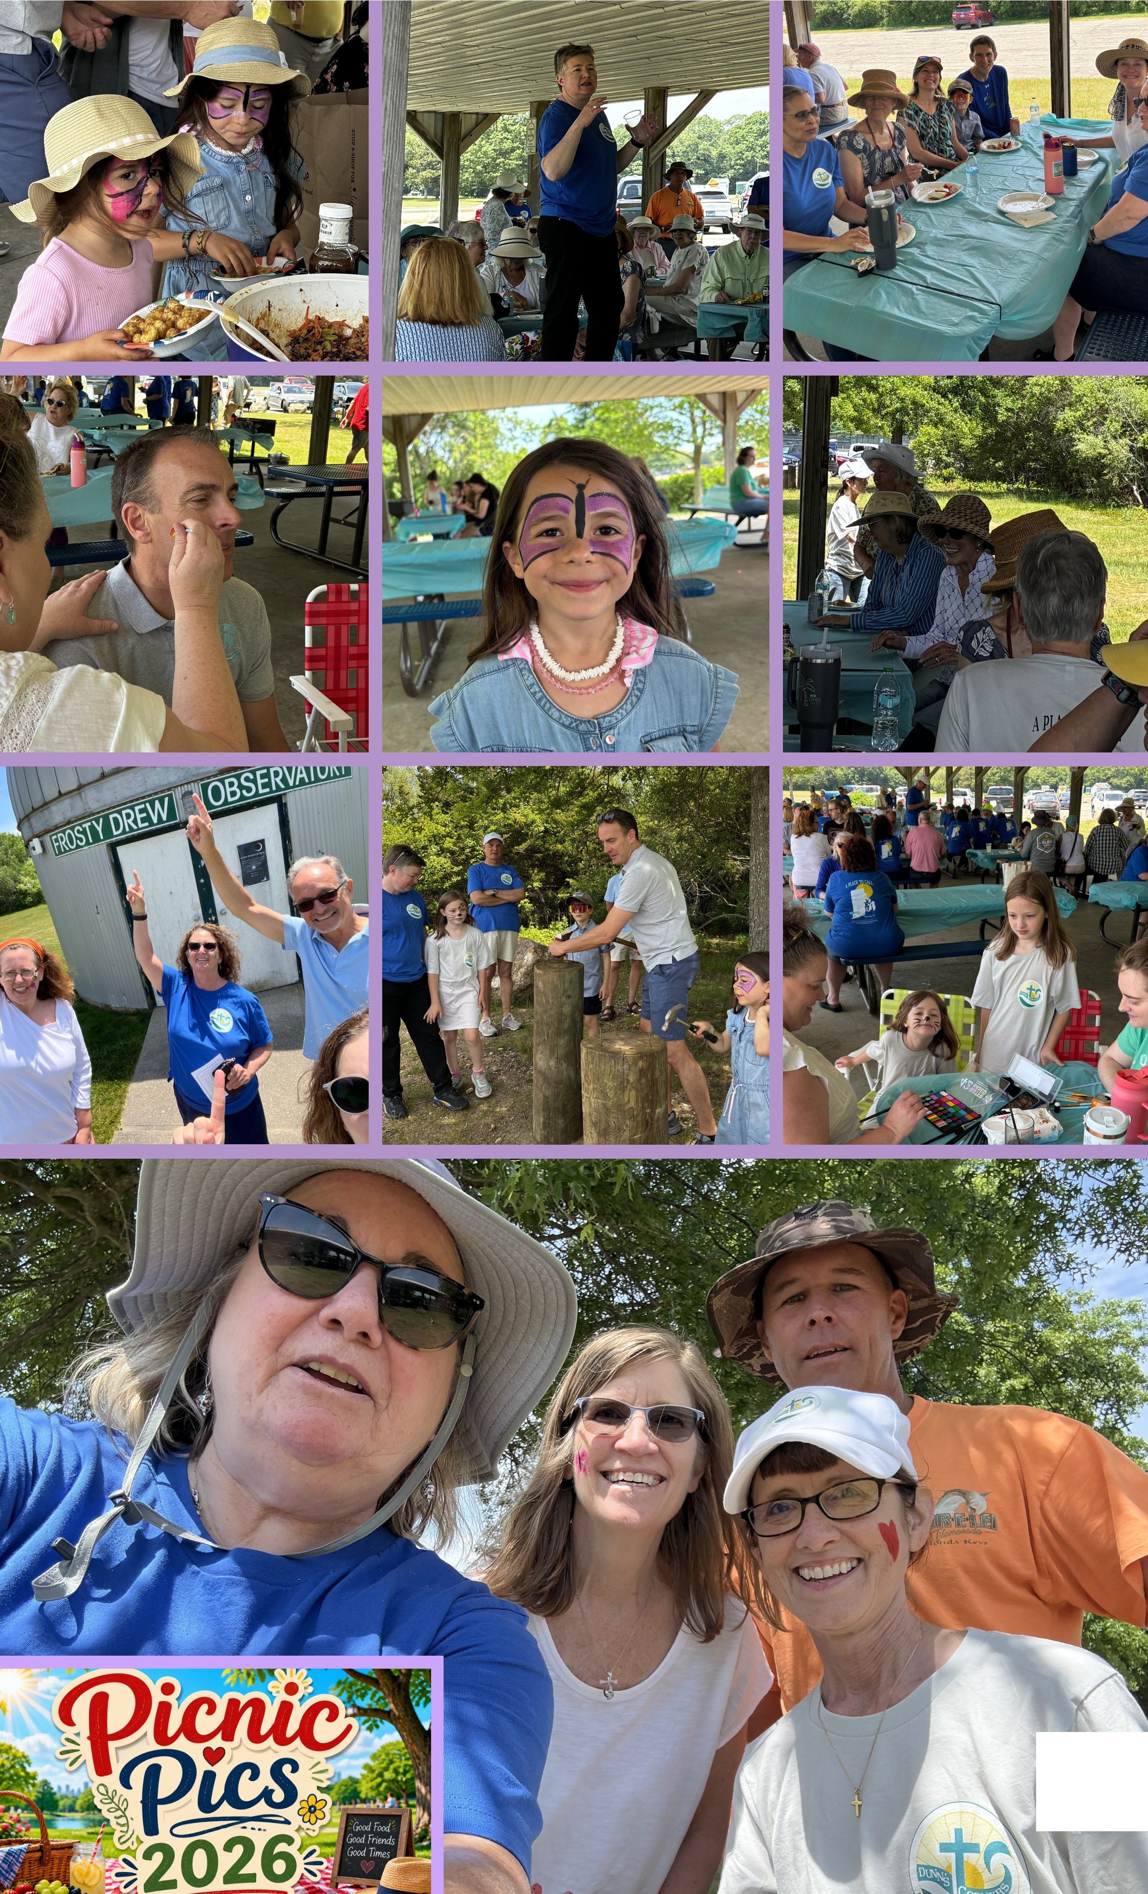
10

Slide 11













lt@M @ 0ffi)W70 @l
Oin)l'iln)@rj l£®7£(§} @®
Vacation Bible School
Registration is open! VBS begins July 13^{t h} through the 17th.
Ages 3-11 may join us for a fun filled week of adventure. Activities, scripture, music, snacks, and loads of fun! scan the code to register.
Chapel in the Pines
Chapel in the Pines summer 2026 season
continues. 8 am services are held Sundays through the end of August. In the event of bad weather services will be held in the church.
Hymn Sing & Ice Cream Social
Friday July 10 for an evening of music and ice cream. The social group at DCCCP is sponsoring a hymn sing on Friday, July 10 at 6:00 PM followed by ice cream in fellowship hall. Weather permitting the hymn sing will be outdoors in the Chapel in the Pines. This is a chance to sing some of your favorite hymns no matter what season they are from.
Hope to see you there!
Please sign up in fellowship hall -
we want to be sure that we have enough ice cream.
6pm - July 10, 2026
Chapel in the Pines 221Post Road Westerly RI
\
Lights & Sights Cruise
Sat, Aug 1 st at 2pm
This tour heads east to Rhode Island and passes Latimer Reef Light, Simmons Castle, the Ocean House, Watch Hill Light - among others, on an adventure that merges maritime history with architectural gems. Tickets are: $26.25 for over 12 yo and
$13.13 under 12 yo. See Cathy Kellers 401.742.4592 or cmek313@earthlink.net for tickets.
t· --■ -■-■-■-■-■-■-■-■-■-■-■-■-■-■-■-■-■-■-■-■-■-■-■-■-■-■-■-■-■-■-■-■-■-■-■-■-■-■-■-■-■-■-■-■ ..
Lot imer Reel Light I Simmons Castle
The Ocean House I Watch Hill Lighthou se I Maritime History& more
c
:
"iME :
Jo;n us os we soil from New London to Rhode Island, uncovaring the stories of ma ritime h iSI O<y and stunning arch octural londmarks along the sc8oic coostline! Come experience a breathtaking lighthouse tourl
Q
■
■
■
= 1 : : : : :: : ·:i: : : ;;;;:!:. : -:; l>M : Upcoming Events - More info to come!
Tlch t• a,. :$26. 26 forov., 1zy,. and$ 13.13underl2yr •.
:
0 9 1
L.!:===========-------------E= • Sun, Sept 13th : Rally day
Summer Book Sale
The PW Summer Book Sale will take place in Fellowship Hall from Sunday, August 2 through
Sunday, August 30.
See more details on page
Fri, Sept 11th at 6pm: showing of 'Come From Away' in Fellowship Hall
Sat, Sept 12th at 10:30am: Hike and Picnic at Fort Adams in Newport, RI Sat, Oct 10th 9:30am: Newport Rail
Trail followed by lunch •
Fri, Dec 11th 7:30pm: showing of
;
SATURDAY ~AUGUSTS, 15, 22, 29
9AM-12PM
DUNN'S CORNERS COMMUNITY CHURCH
221 POST ROAD WESTERLY RI
'Best Christmas Pageant Ever' at
:
t.•••gr J!r.! .tr. ._..._.. --·. --·......_..._.. ._.,/ 11

Slide 12


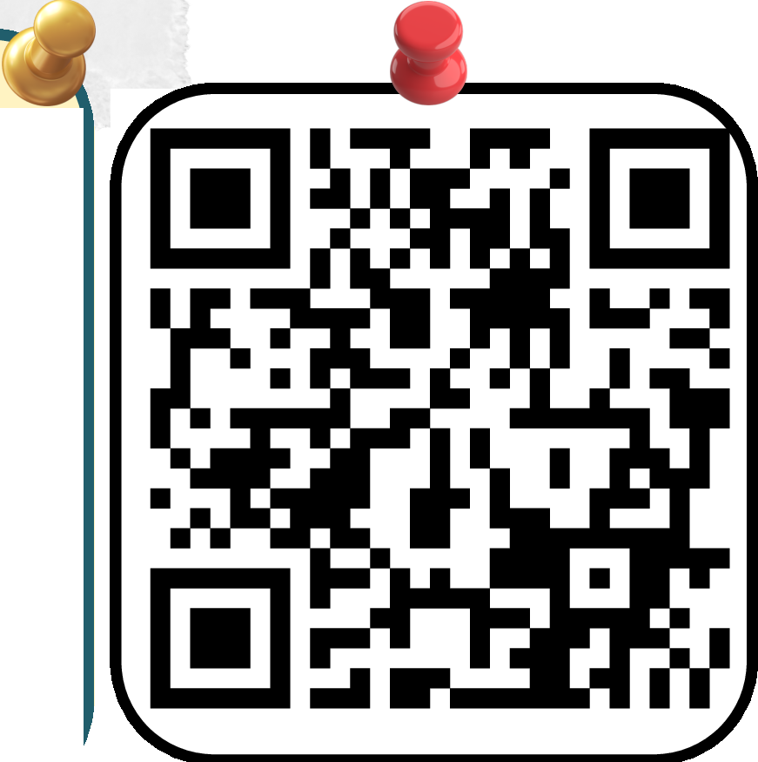




NEWt EASY ONLINE GIVING •
We're excited to introduce a simpler more user-friendly -..1ay to give online! Just scan the QR code to access our updated giving page-no-..1 designed -..1ith a clear easy-to-use format to make your experience 9uick and seamless. Whether you're making a one-time gift or setting up recurring giving it's never been easier to support the life and ministry of our church. Thank you to Rachel for creating this positive and helpful update to our -..1ebsite!
Your generosity makes a difference­
thank you for supporting our community.
The Building and Grounds Committee is pleased to announce the expansion of our dedication patio, inspired by Martha Rice's thoughtful idea. Located adjacent to the two main exterior doors of the church sanctuary, this program offers the opportunity for individuals to personalize a brick with a message in honor or memory of someone, a family name, pet name, or a biblical quote. Each brick is available for $50, with all net proceeds supporting the purchase of new padded folding chairs for the fellowship hall.
An informational table will be set up in the fellowship hall, where forms for brick purchases can be completed. Once all forms are submitted, we will proceed with ordering the bricks, verify the accuracy of inscriptions upon arrival, and coordinate installation with the Tuesday Guys.
For further details, please contact Don Phillips at 401-258-0214 or Robyn Generali at 203-592-9226.
Church Office: (401) 322-0655
Fax#: (401) 322-1740
E-mail: dunnschurch@gmail.com
Web: www.dunnscornerschurch.org Facebook:dunnscornerschurch
CINIACTS
Clerk of Session: Roxanne Tisch Building & Grounds: Charles Jones Christian Education: Dan Charette Compliance: Grant Showacre
ELC: Sally Owen
Treasu rer / Trustee: Cathy Keller
Mission: Rachel Pierson Membership and Communication:
Bruce Yarnall Nomination: Staci Heep &
Cathy Kellers Personnel: Bob Santy Stewardship: Charles Jones Worship &Music: Lynn Getty Deacons: Sandy Santy Trustees: David Capaldi
Finance Secretary: Rachel Pierson
Ro xanne.t isch @g m ai l.co m mst 3do g s@g m ai l.com dcharette78@ver izon.net g.showacre@yahoo.com saIly@sa Ilyowen.com cmek313@gmail.com rachelpiers@gmail.com
The Reverend Gin Courtney: gincourtney@gmail.com Nancy Fortin, Office Manager: dunnschurch@gmail.com
Andrew McCau/ey-Wa//ace,Music Director: music.d cccp @g m ai l.com
Chery/ Banker, Organist:
bankerbuzz@g m ai l.com Kathy Koziol, Music Assistant:
kathykoziol@gmail.co
Mary S/attery,Chi/dren's Ministry Coordinator: mfs1att er y0 3@g m ai l.com
Michael Wa/ton,Youth Ministry Director: michaelwalto ngo ld @g m ai l.com
Jaye Simmons,Communications Specialist:
com municat io ns.dc ccp @g mai I.com
Christine Fish,Director Early Learning Center, Director Kid Kare:
(401)322-0510
dccelcdirector@yahoo.com
bya rn ell @j u no. com staciheep@aol.com cmek313@gmail.com rwsanty@comcast.net mst 3d o gs @g m ai l.com lgett y@g m ai l.com sandysanty@comcast.net dacapaldi@aol.com rachelpiers@gmail.com
12

Slide 13
JULY 2026
SUNDAY | MONDAY | TUESDAY | WEDNESDAY | THURSDAY | FRIDAY | SATURDAY
28 | 29 | 30 | l 9am - Coffice Hours 1 0am - Bible Study 1:30pm - Westerly Village | 2 | 3 | 4 •• HAPPY• • [,u( •* DAY * •
5 Communion Sunday 8 & 10am Worship 9 & 11am Fellowship 10am Sunday School | 6 | 7 8:30am - Work Team 5pm - Christian Ed 5:30pm - Teen Time 6pm - Building Grounds | 8 9am - Coffice Hours 10am - Bible Study 1:30pm - Westerly Village | 9 | 10 6pm - Hymn sing and ice cream | 11 8:30am - Habitat for Humanity
12 | 13 9am - VBS | 14 9am - VBS | ₁₅ 9am -VBS | ₁₆ 9am - VBS | ₁₇ 9am - VBS | 18
8 & 10am Worship 9 & 11am Fellowship 10am Sunday School |  | 8:30am - Work Team 2pm - Westerly Village 5:30pm - Teen Time
19 | 20 | 21 8:30am - Work Team :,:30pm - Griefshare :,:30pm - Teen Time | 22 | 23 | 24 | 25 Quilt Show
8 & 10am Worship 9 & 11am Fellowship 10am Sunday School |  |  | 9am - Coffice Hours 10am - Bible Study 1:30pm - Westerly Village |  | Quilt Show Set-up
26 8 & 10am Worship 9 & 11am Fellowship 10am Sunday School 12pm - Quilt Show c/L | 27 | 28 8:30am - Work Team 5:30pm -Teen Time | 9²am⁹PW Book sale set-up 9am - Coffice Hours 10am - Bible Study 1:30pm - Westerly Village | 30 | 31 | l
AUGUST 2026
SUNDAY | MONDAY | TUESDAY | WEDNESDAY | THURSDAY | FRIDAY | SATURDAY
26 | 27 | 28 | 29 | 30 | 31 | l 8am - Warm dinner drop 2pm - Boat trip
₂ PW book Sale Communion 8 & 10am Worship 9 & 11am Fellowshi 10am Sunday School | 3 | 84l 0am - Work Team 4pm - Worship Com 5pm - Christian Ed 5:30pm - Teen Time 6pm - Building | 5 1:30pm - Westerly Village | 6 | 7 | 8 9am PW book Sale
₉ PW book Sale 8 & 10am Worship 9 & 11am Fellowshi 10am Sunday School | 10 | 11 8:30am - Work Team 2pm - Westerly Viii. 5:30pm - Teen Time 7pm - Session | 12 1:30pm - Westerly Village | 13 | 14 | 15 9am PW book Sale
₁₆ PW book Sale 8 & 10am Worship 9 & 11am Fellowshi 10am Sunday School | 17 | 18 8:30am - Work Tean 5:30pm - GriefsharE 5:30pm - Teen Time | 19 1:30pm - Westerly Village | 20 Sanctuary Carpet | 21 Sanctuary Carpet | 22 Sanctuary Carpet 9am PW book Sale
PW book Sale 23 8 & 10am Worship 9 & 11am Fellowshi 10am Sunday School | 24 | 25 8:30am - Work Team 5:30pm - Teen Time 7pm - Deacons | 26 1:30pm - Westerly Village | 27 | 28 | 29 9am PW book Sale
₃₀ PW book Sale 8 & 10am Worship 9 & 11am Fellowshi 10am Sunday School | 31 | l | 2 | 3 | 4 | 5
13

Slide 14







DUNN'S CORNERS COMMUNITY CHURCH, PRESBYTERIAN
221 Post Road
Westerly, RI 02891
Non-Profit Organization
US Pos tage Paid W ester ly, RI 0 2891
Permit No. 145
Return Service Requ
The Sc r ib e
Jidy/c.i/l{ff_t{tlt 2026
David Capaldi - June 4th
Dee Gillam - June 26th Bruce Loeckler - August 1st Chant Clapham - August 7th Yvette Drurey - August 27th
Diamonds (70 and beyond), please
contact the Church Office at
(401) 322-0655 or sign up on the bulletin board in Fellowship Hall and
add your name to our list.

